Slide 1


Deep Learning for Detecting Mental Health Disorders using Social Media Generated Content
Student: Luke Abela Student No: 200588919 Supervisor: Dr. Arkaitz Zubiaga Course: Artificial Intelligence MSc

Slide 2

Overview
Motivation & Background
Preliminary Material
Data, Data Augmentation, and Pre-processing
Text Classification Models
Results, Discussion and Conclusion

Slide 3
Motivation
The Rise of the Internet, particularly Social Media
The Increasing Prevalence of Mental Health

Slide 4
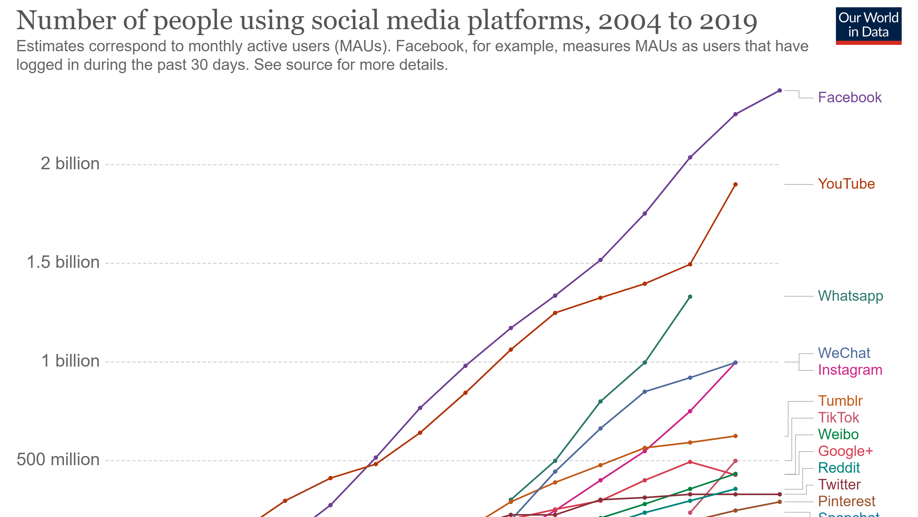
The Rise of Social Media

Slide 5
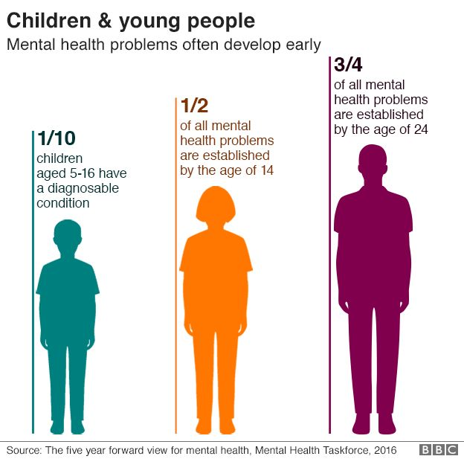
The Prevalence of Mental Health

Slide 6
Background
Previous works in the field: using crafted features in Machine Learning
Finding the optimal set of features – e.g., TF-IDF
Linguistic Inquiry Word Count Lexicon (LIWC)
More recent work: applying deep learning
Overall: better performance, but harder to explain why.
No widely accepted method implemented yet, but promising results in certain papers …

Slide 7
Deep Learning Techniques
Word Embeddings
Deep Averaging Neural Networks
Convolutional Neural Networks
Long-term Short-term Neural Networks
Bidirectional Encoded Representations from Transformers (BERT) & similar

Slide 8
Data
Sub-Reddit Title | Number of Posts | Reddit Description
Anxiety | 19976 | Discussion and support for sufferers and loved ones of any anxiety disorder.
Autism | 4576 | Autism news, information, and support. Please feel free to submit articles to enhance the knowledge, acceptance, understanding and research of Autism and ASD.
Bipolar | 2720 | A safe haven for Bipolar related issues. We are a community here not just a help page. Be a part of something that cares about who you are.
BPD | 11007 | A place for those who have BPD (also known as EUPD), their family members and friends, and anyone else who is interested in learning more about the mental illness.
Depression | 21209 | Peer support for anyone struggling with a depressive disorder.
Schizophrenia | 42481 | N/A – private community
Mental Health | 18925 | The Mental Health sub-Reddit is the central forum to discuss, vent, support and share information about mental health, illness, and wellness.
Dataset for such a project is typically derived from Reddit or Twitter (free public forum based posting sites).
Data from ‘Natural Language Processing Reveals Vulnerable Mental Health Support Groups and Heightened Health Anxiety on Reddit During COVID-19: Observational Study’ - Low, Daniel M; Rumber, Laurie; Talker, Tanya; Torous, John; Cecchi, Guillermo; Chosh, Satrajit S,

Slide 9
Data Augmentation Methods
Many options to consider!
Easy Data Augmentation (EDA)
A Rule-based approach
4 different operations:
Synonym Replacement
Random Insertion
Random Swap
Random Deletion

Slide 10
Pre-processing
For custom models
Standard NLP practices of text pre-processing for classification
Removal of Upper-case Letters and Stop Words.
Strip punctuation, alphanumeric characters, and extra whitespaces.
For models with pre-trained embeddings:
The respective tokenizer of the transformer used.

Slide 11
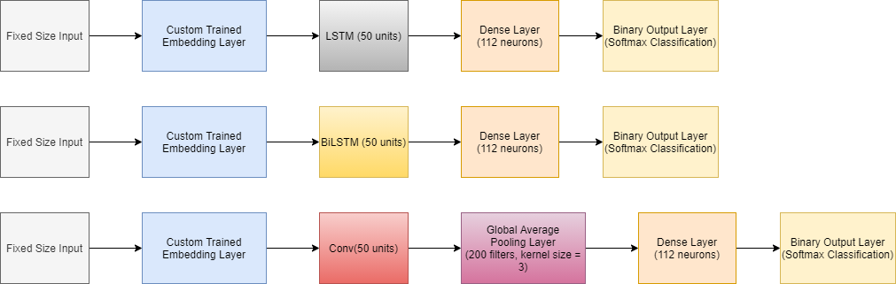
Text Classification Models with Custom Embeddings
Training using Tensorflow for a maximum of 30 epochs.
The Adam optimizer was used along with binary cross entropy loss
Early Stopping was accomplished by monitoring for limited change in validation loss over 5 epochs.
The transformers used were DistilBERT and RoBERTa.

Slide 12
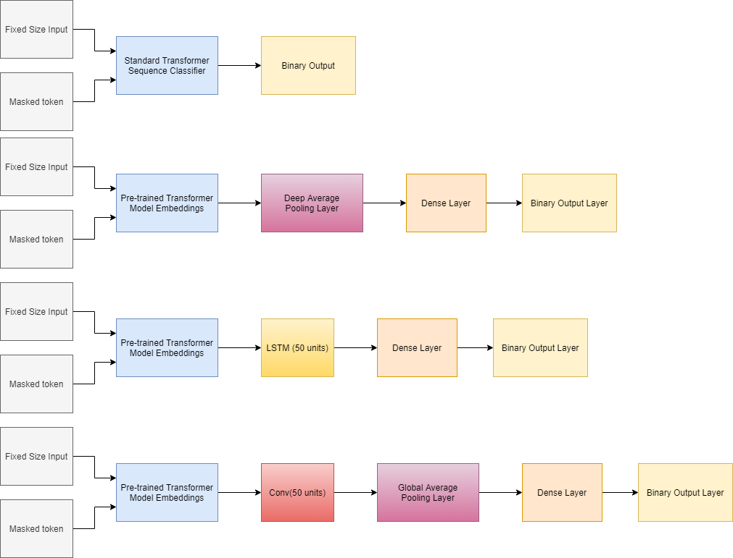
Text Classification Models with Pre-trained Embeddings
Initially trained with a maximum of 30 epochs, but peak performance typically reached within initial 3-5 epochs.
The Adam optimizer was used along with binary cross entropy loss

Slide 13
Results

Slide 14
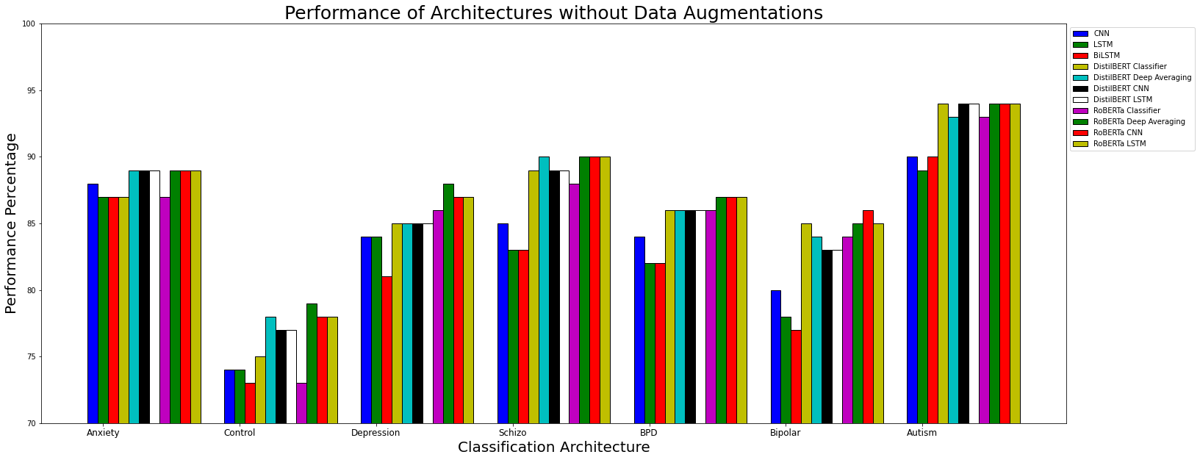
Performance of Architectures without Data Augmentation

Slide 15
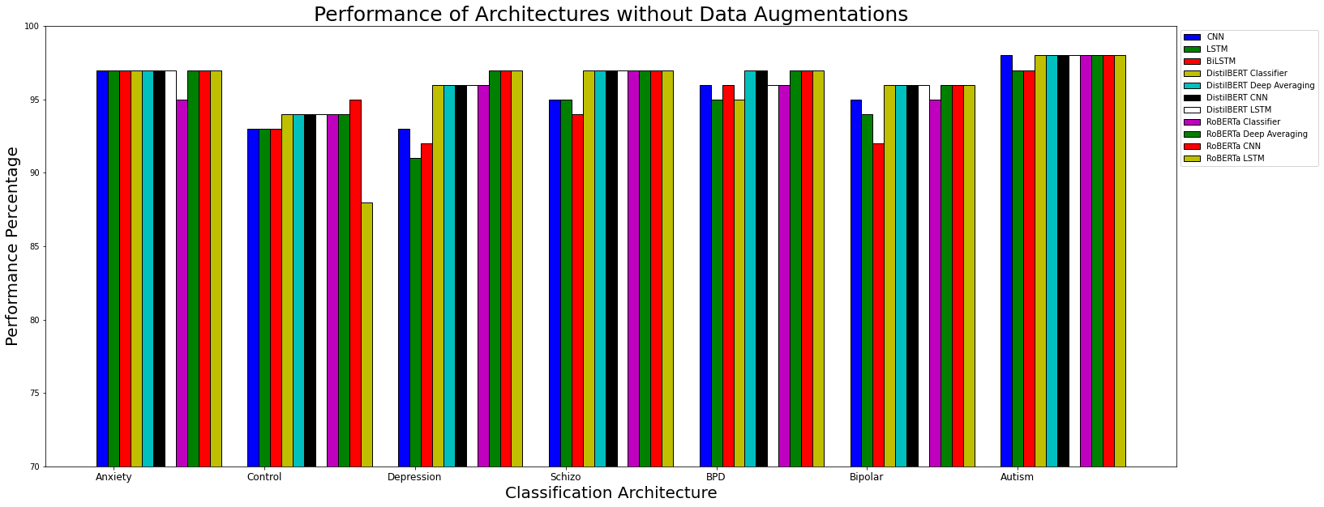
Performance of Architectures with Data Augmentation

Slide 16
Discussion
CNNs vs LSTMs
Varying performance between Architectures for same Dataset
The effect of Transformer Models and their pre-trained embeddings
The role of Data Augmentation

Slide 17
Conclusions & Future Work
Tackled a potential multi-label task as a series of binary classifiers.
Great performance achieved with use of Data Augmentation complimented with pre-trained Transformer Embeddings
Potential further tasks could include ensuring the text classifier could generalise to other sites beyond Reddit, and taking advantage of other data in posts: photos, videos, gifs etc …
Questions remain on the assumptive nature of the dataset.

Slide 18

Thank you

Slide 19
References
Low, D. M. et al., 2020. Natural Language Processing Reveals Vulnerable Mental Health Support Groups and Heightened Health Anxiety on Reddit During COVID-19: Observational Study. Journal of medical Internet research, 22(10).

